Slide 1
Lecture 6 List and Tuples
Topics
Sequences
Introduction to Lists
Finding Items in Lists with the in Operator
List Methods and Useful Built-in Functions
Plotting List Data with the matplotlib

Slide 2
Sequences
Sequence: an object that contains multiple items of data
  The items are stored in sequence one after another
Python provides different types of sequences, including lists and tuples
  The difference between these is that a list is mutable and a tuple is immutable

Slide 3
Introduction to Lists
List: an object that contains multiple data items
  Element: An item in a list
  Format: list = [item1, item2, etc.]
  Can hold items of different types
print function can be used to display an entire list
list() function can convert certain types of objects to lists

Slide 4
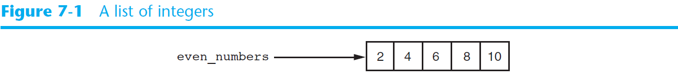
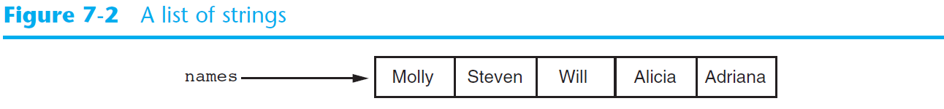
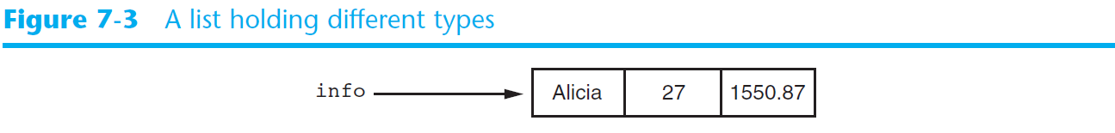
Introduction to Lists (cont’d.)

Slide 5
The Repetition Operator and Iterating over a List
Repetition operator: makes multiple copies of a list and joins them together
  The * symbol is a repetition operator when applied to a sequence and an integer
    Sequence is left operand, number is right
  General format: list * n
You can iterate over a list using a for loop
  Format: for x in list:

Slide 6
Indexing
Index: a number specifying the position of an element in a list
  Enables access to individual element in list
  Index of first element in the list is 0, second element is 1, and n’th element is n-1
  Negative indexes identify positions relative to the end of the list
    The index -1 identifies the last element, -2 identifies the next to last element, etc.

Slide 7
The len function
An IndexError exception is raised if an invalid index is used
len function: returns the length of a sequence such as a list
  Example: size = len(my_list)
  Returns the number of elements in the list, so the index of last element is len(list)-1
  Can be used to prevent an IndexError exception when iterating over a list with a loop

Slide 8
Lists Are Mutable
Mutable sequence: the items in the sequence can be changed
  Lists are mutable, and so their elements can be changed
An expression such as
list[1] = new_value can be used to assign a new value to a list element
  Must use a valid index to prevent raising of an IndexError exception

Slide 9
Concatenating Lists
Concatenate: join two things together
The + operator can be used to concatenate two lists
  Cannot concatenate a list with another data type, such as a number
The += augmented assignment operator can also be used to concatenate lists

Slide 10
List Slicing
Slice: a span of items that are taken from a sequence
  List slicing format: list[start : end]
  Span is a list containing copies of elements from start up to, but not including, end
    If start not specified, 0 is used for start index
    If end not specified, len(list) is used for end index
  Slicing expressions can include a step value and negative indexes relative to end of list

Slide 11
Finding Items in Lists with the in Operator
You can use the in operator to determine whether an item is contained in a list
  General format: item in list
  Returns True if the item is in the list, or False if it is not in the list
Similarly you can use the not in operator to determine whether an item is not in a list

Slide 12
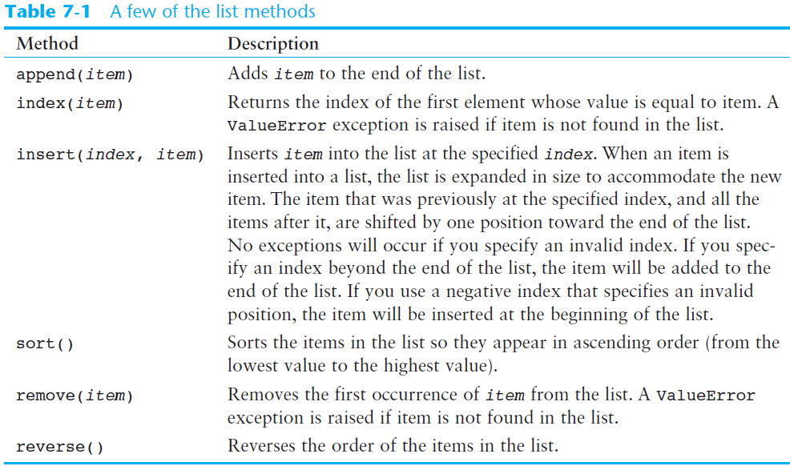

Slide 13
List Methods and Useful Built-in Functions
del statement: removes an element from a specific index in a list
  General format: del list[i]
min and max functions: built-in functions that returns the item that has the lowest or highest value in a sequence
  The sequence is passed as an argument

Slide 14
Processing Lists
List elements can be used in calculations
To calculate total of numeric values in a list use loop with accumulator variable
To average numeric values in a list:
  Calculate total of the values
  Divide total of the values by len(list)
List can be passed as an argument to a function

Slide 15
Tuples
Tuple: an immutable sequence
  Very similar to a list
  Once it is created it cannot be changed
  Format: tuple_name = (item1, item2)
  Tuples support operations as lists
    Subscript indexing for retrieving elements
    Methods such as index
    Built in functions such as len, min, max
    Slicing expressions
    The in, +, and * operators

Slide 16
Tuples (cont’d.)
Tuples do not support the methods:
  append
  remove
  insert
  reverse
  sort

Slide 17
Plotting Data with matplotlib
The matplotlib package is a library for creating two-dimensional charts and graphs.
It is not part of the standard Python library, so you will have to install it separately, after you have installed Python on your system.

Slide 18
Plotting Data with matplotlib
The matplotlib package contains a module named pyplot that you will need to import.
Use the following import statement to import the module and create an alias named plt:
import matplotlib.pyplot as plt
For more information about the import statement, see Appendix E in your textbook.

Slide 19
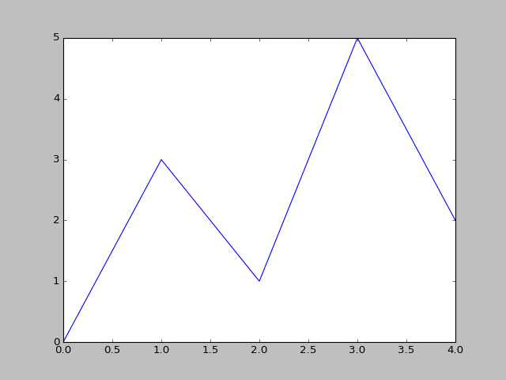
Plotting a Line Graph with the plot Function
Program 7-19 (line_graph1.py)
1 # This program displays a simple line graph.
2 import matplotlib.pyplot as plt
3
4 def main():
5 # Create lists with the X and Y coordinates of each data point.
6 x_coords = [0, 1, 2, 3, 4]
7 y_coords = [0, 3, 1, 5, 2]
8
9 # Build the line graph.
10 plt.plot(x_coords, y_coords)
11
12 # Display the line graph.
13 plt.show()
14
15 # Call the main function.
16 main()

Slide 20
Plotting a Line Graph with the plot Function
You can change the lower and upper limits of the X and Y axes by calling the xlim and ylim functions. Example:
This code does the following:
  Causes the X axis to begin at 1 and end at 100
  Causes the Y axis to begin at 10 and end at 50
plt.xlim(xmin=1, xmax=100)
plt.ylim(ymin=10, ymax=50)

Slide 21
Plotting a Line Graph with the plot Function
You can customize each tick mark's label with the xticks and yticks functions.
These functions each take two lists as arguments.
  The first argument is a list of tick mark locations
  The second argument is a list of labels to display at the specified locations.
plt.xticks([0, 1, 2, 3, 4],
['2016', '2017', '2018', '2019', '2020'])
plt.yticks([0, 1, 2, 3, 4, 5],
['$0m', '$1m', '$2m', '$3m', '$4m', '$5m'])

Slide 22
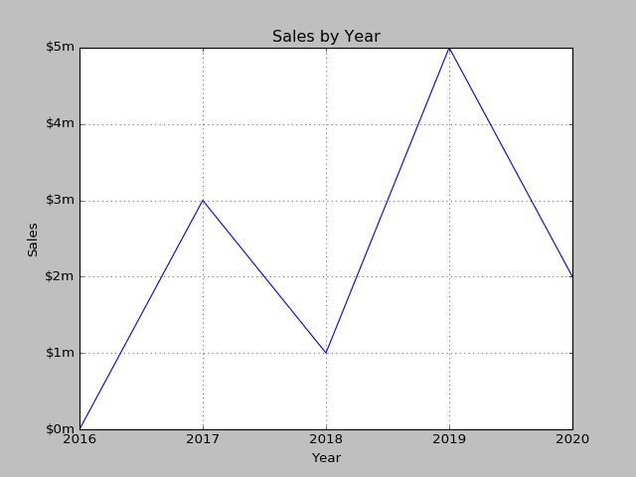
Output of Program 7-24
Displayed by the yticks() function.
Displayed by the title() function.
Displayed by the ylabel() function.
Displayed by the xticks() function.
Displayed by the xlabel() function.

Slide 23
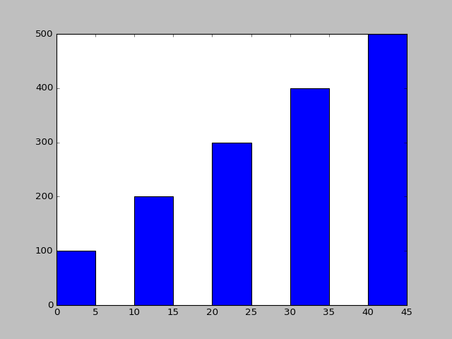
Plotting a Bar Chart
The default width of each bar in a bar graph is 0.8 along the X axis.
You can change the bar width by passing a third argument to the bar function.
left_edges = [0, 10, 20, 30, 40]
heights = [100, 200, 300, 400, 500]
bar_width = 5
plt.bar(left_edges, heights, bar_width)
plt.show()

Slide 24
Plotting a Bar Chart
The bar function has a color parameter that you can use to change the colors of the bars.
The argument that you pass into this parameter is a tuple containing a series of color codes.
Color Code | Corresponding Color
'b' | Blue
'g' | Green
'r' | Red
'c' | Cyan
'm' | Magenta
'y' | Yellow
'k' | Black
'w' | White

Slide 25
Plotting a Pie Chart
You use the pie function in the matplotlib.pyplot module to create a pie chart.
When you call the pie function, you pass a list of values as an argument.
  The sum of the values will be used as the value of the whole.
  Each element in the list will become a slice in the pie chart.
  The size of a slice represents that element's value as a percentage of the whole.

Slide 26
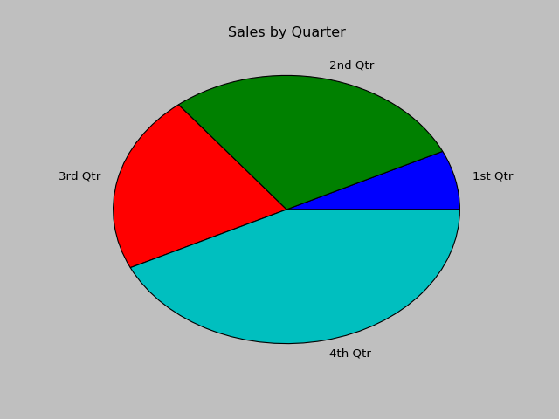
Plotting a Pie Chart
Example
sales = [100, 400, 300, 600]
slice_labels = ['1st Qtr', '2nd Qtr', '3rd Qtr', '4th Qtr']
plt.pie(sales, labels=slice_labels)
plt.title('Sales by Quarter')
plt.show()

Slide 27
Summary
This chapter covered:
  Lists, including:
    Repetition and concatenation operators
    Indexing
    Techniques for processing lists
    Slicing and copying lists
    List methods and built-in functions for lists
  Tuples, including:
    Immutability
  Plotting charts and graphs with the matplotlib

